Slide 1

BOX480
End-to-End Smart Hotel Platform
Guest Control · HotelTV · Mobile App · Robot Services · Data Operations — All in One Platform
HOTEKEY | Guangzhou Hotekey Electronics Co., Ltd.
Guangzhou, China · Singapore
www.hotekey.com

Slide 2
The Hotel Digital Dilemma
Hotels today face a paradox: guests expect Hilton-level smart experiences, but most properties run on fragmented, disconnected systems.
The result: a technology stack that works against the hotel, not for it.
THE REALITY IN MOST HOTELS TODAY
PMS (Property Management System) -- runs check-in, billing, housekeeping
Guest Control System -- runs lights, AC, curtains (if present at all)
TV System -- runs in-room entertainment, welcome messages
Mobile App -- runs guest services, room orders
Robot Platform -- runs delivery robots (separate system)
Five systems. Zero integration. Each with its own login, database, and vendor.
HOTEKEY | BOX480 Platform | www.hotekey.com
2

Slide 3
What Fragmentation Costs You
When systems don't talk to each other, the hotel pays — in money, time, and guest experience.
GUEST FRUSTRATION
Guest uses the mobile app to set DND. The TV still plays welcome messages. The doorbell still rings. The guest leaves a 2-star review for "broken technology."
STAFF OVERLOAD
Front desk juggles 5 different systems. PMS for check-in. TV system for welcome message. Guest control for room readiness. Robot system for deliveries. Each with separate training, separate passwords, separate vendors to call when things break.
DATA SILOS
The guest control system knows a room is empty. The PMS doesn't. The AC runs at full power for 3 days. Multiply by 200 rooms. That's real money.
MANAGEMENT BLIND SPOTS
No single dashboard. No unified analytics. General manager makes decisions on instinct, not data.
HOTEKEY | BOX480 Platform | www.hotekey.com
3

Slide 4
73%
of guests prefer hotels with smart room technology
Today's travelers carry supercomputers in their pockets. They control their homes with voice commands. They expect the same -- or better -- in a hotel room they're paying for.
The bar has been set by Hilton Connected Room, Marriott Bonvoy, and Airbnb's smart home hosts. Guests don't compare you to other hotels -- they compare you to their own homes.
Can your property deliver?
HOTEKEY | BOX480 Platform | www.hotekey.com
4

Slide 5
The Integration Gap: Why Most Hotels Stay Fragmented
THE CHALLENGE
THE BOX480 ANSWER
Integrating 5+ separate systems is HARD:
Each vendor uses different protocols
PMS integration requires custom dev
APIs change without notice
No vendor wants to own the integration
"That's not our scope" is the universal answer
Integration costs often exceed hardware costs
End result: hotels buy 5 great products that don't work together. The sum is less than the parts.
One platform. One vendor. One integration.
We build all 5 systems ourselves
They're designed to work together from day 1
PMS integration is a core feature, not an add-on
Single vendor = single point of accountability
One dashboard for the entire hotel
One training program for all staff
BOX480 doesn't connect systems -- it IS the system. Guest control, TV, mobile, robots, data ops -- all built as one.
HOTEKEY | BOX480 Platform | www.hotekey.com
5

Slide 6
Six Core Competencies, One Unified Platform
BOX480 is not a guest control system with some extras. It is an end-to-end smart hotel platform architected from the ground up to replace every fragmented system a hotel runs.
1. PMS DATA INTEGRATION -- Bi-directional sync with Opera, Fidelio, and 30+ PMS platforms. Check-in triggers room setup. Check-out triggers energy save. No middleware. No translation layer.
2. MODULAR GUEST CONTROL -- 17-channel fusion module (R17), 0-10V dimming, TRIAC dimming, curtain control, HVAC integration. All on RS-485 bus. DIN-rail standard. Mix and match modules per room type.
3. TV VOICE & SMART SCREEN -- HotelTVOS running on smart TVs. Voice control for room devices. PMS-linked welcome messages. Content ecosystem with licensed entertainment.
4. MOBILE ALL-IN-ONE -- Single app for check-in, room control, service requests, hotel info, and in-room dining. White-label or embed into existing hotel app.
5. HOTEL TV SYSTEM -- DTMB, IPTV, OTT integration. Six UI themes. Multi-language. Supports projector rooms, smart set-top boxes, and voice remotes.
6. DATA OPERATIONS PLATFORM -- Unified SaaS dashboard. Energy analytics per room. Guest behavior insights. Marketing campaign tools. Membership system. All four hotel management systems in one.
HOTEKEY | BOX480 Platform | www.hotekey.com
6

Slide 7
Why "All-in-One" Is Not a Buzzword
The industry has trained hotels to expect fragmentation. "Buy the best TV system from Vendor A, the best guest control from Vendor B, integrate them later." This is terrible advice. Here's why:
INTEGRATION IS THE PRODUCT
When a guest says "goodnight" to the TV and the lights dim, curtains close, and AC adjusts -- that seamless experience IS the product. It cannot be assembled from 3 different vendors with 3 different APIs and 3 different support teams.
SINGLE VENDOR ACCOUNTABILITY
When something breaks, there is one phone number. One support ticket. One team that owns the entire stack from the TV screen to the light switch.
CONSISTENT UX
The mobile app, TV interface, and physical panels share the same design language. Guests don't feel like they're using 5 different products. They feel like they're in a well-designed hotel.
FUTURE-PROOF
When we add a feature -- say, AI-powered energy optimization -- it works across all subsystems on day 1. No waiting for 3 other vendors to build their side.
HOTEKEY | BOX480 Platform | www.hotekey.com
7

Slide 8

01
The Platform
System Architecture & Core Hardware
HOTEKEY | BOX480 Platform | www.hotekey.com
1

Slide 9
End-to-End Architecture: Every System, One Brain
BOX480 unifies five traditionally separate hotel technology stacks into one coherent platform:
GUEST-FACING LAYER
Switch Panels (D/M/G Series) + TV Screen (HotelTVOS) + Mobile App + Voice Assistant + In-room Smart Speaker. Every guest touchpoint runs on the same backend. A "sleep" command from any interface triggers the exact same sequence.
CONTROL LAYER
BOX480 Core (AI Gateway + Power Module + R17 Fusion Module). All room devices connect via RS-485 bus. Modular expansion: add dimming, curtain, and HVAC modules as needed. Standard 35mm DIN-rail for electrical cabinets.
SERVICE LAYER
Robot integration (Jingwu, Qinglang, Ninebot, etc.), smart service workflow (guest request -> staff assignment -> delivery tracking -> completion notification), PMS bi-directional sync.
CLOUD LAYER
SaaS platform: Hotel Management + Hotel O&M + Data Analytics + AIoT IoT. One login. One dashboard. Every room, every device, every guest interaction -- visible and controllable from anywhere.
HOTEKEY | BOX480 Platform | www.hotekey.com
9

Slide 10
The BOX480 Core: Brains of the Room
At the heart of every BOX480 installation is a custom electrical cabinet that replaces the mess of traditional RCU panels:
AI GATEWAY MODULE
32-bit ARM processor. Embedded Linux. RS-485 bus master. Wi-Fi / Ethernet uplink to cloud. Handles all room logic: scene execution, PMS sync, device health monitoring, firmware updates. This is the brain.
POWER MODULE
Clean 12V/24V DC power distribution. Surge protection. All modules powered from a single rail. No separate power supplies for each subsystem.
R17 FUSION CONTROL MODULE
17-channel relay in one DIN-rail unit: 13x 16A + 4x 10A. 2x RS-485 interfaces. 12x IO dry-contact inputs. 32-bit MCU with watchdog. Manual override switches per channel. Memory function remembers last state after power loss.
Core SKUs: TJ-R17-1316-0410 fusion module · TJ-GW-IP-480 AI gateway · TJ.EN25XPW.36 power supply. The entire core fits in a standard 35mm DIN-rail cabinet — one cabinet per room.
HOTEKEY | BOX480 Platform | www.hotekey.com
10

Slide 11
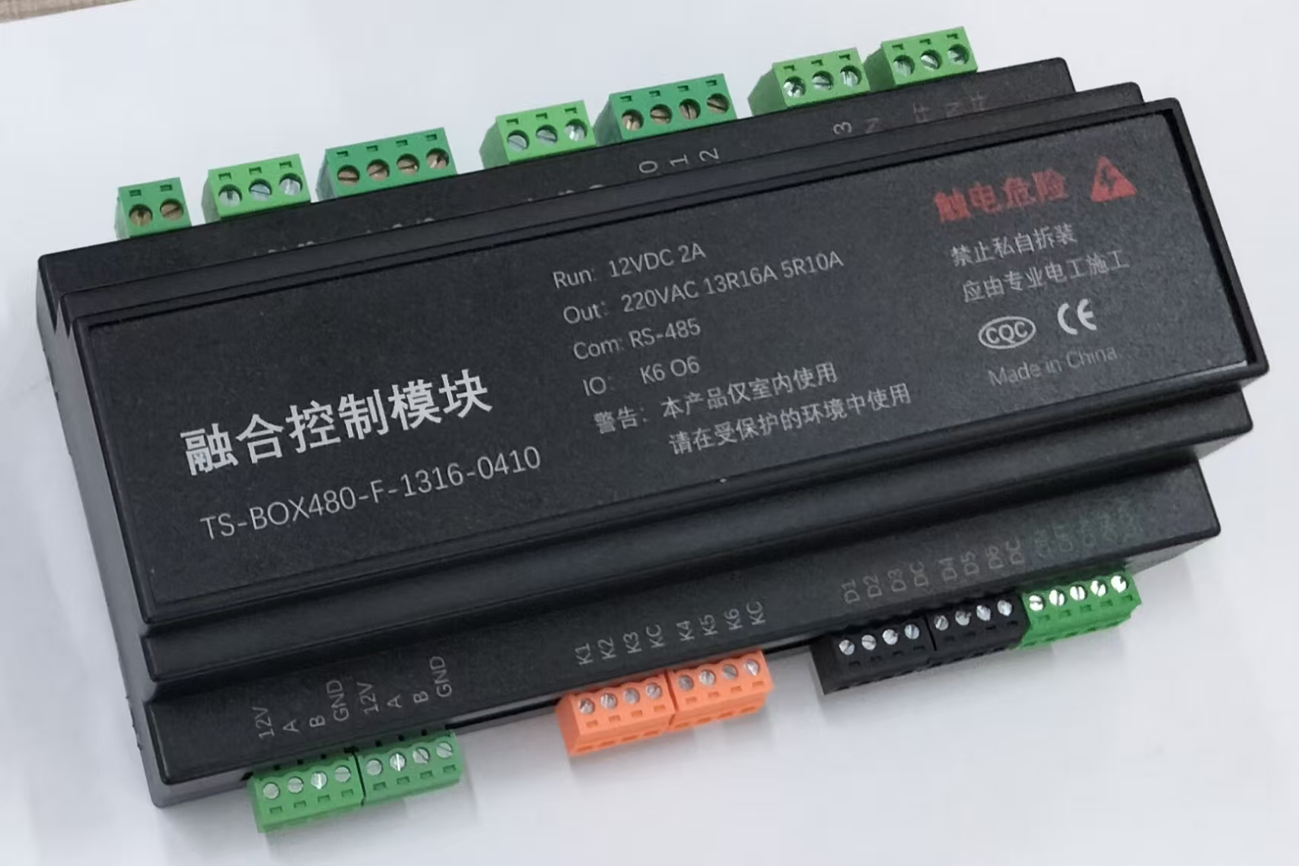
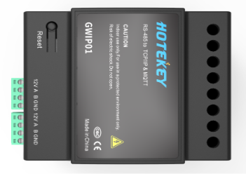
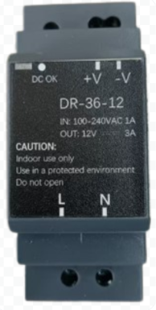
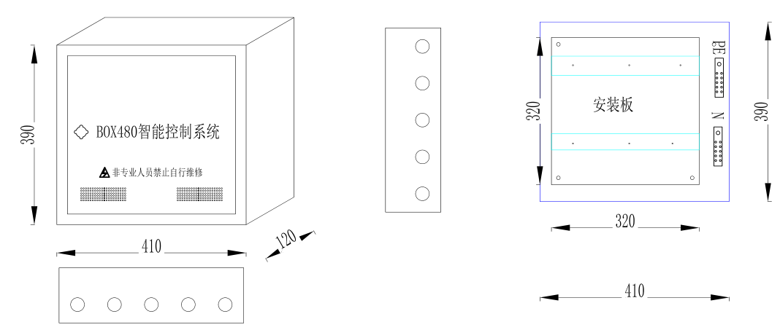
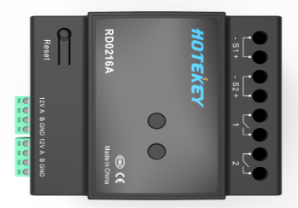
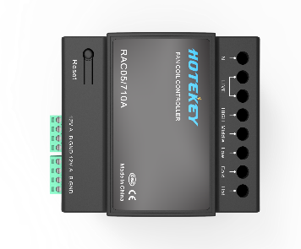
Core Hardware -- R17 Fusion Module & Dimming Controllers
HOTEKEY | BOX480 Platform | www.hotekey.com
11

Slide 12
Dimming & Expansion: Build the Room You Need
DIMMING MODULES
EXPANSION MODULES
0-10V DIMMING (2-Channel)
LED drivers, fluorescent ballasts. Built-in relay for complete off at 0%. Emergency bypass switch per channel. Fade-in/fade-out timing configurable per circuit.
TRIAC DIMMING (2/4-Channel)
Incandescent, halogen, dimmable LED. Phase-cut control. Adjustable zero-cross bias for different load types. Over-current protection. Manual override per channel.
All dimming modules: RS-485 bus, 35mm DIN-rail, LED status indicators, memory function, configurable high/low limits and protection delays. SKUs: TJ.ZX.PWM06 (6-ch PWM) · TJ.ZX.RD02 / TJ.ZX.RD04 (0-10V).
CURTAIN MOTOR MODULE
DC motor control. Open/stop/close/percentage positioning. Ultra-quiet <35dB operation. Manual switch input for direct control. SKU: TJ0204.0801 (4-channel).
HVAC FAN COIL MODULE
3-speed fan control + valve control. Thermostat integration (TJ.ZX.D8.TP.QPS). Occupancy-based auto mode. Supports water-turbine and fluorine valve types.
DRY CONTACT MODULE
Convert any legacy device to RS-485. Door sensors, card readers, DND/MUR indicators, emergency buttons. 8-16 channels per module.
HOTEKEY | BOX480 Platform | www.hotekey.com
12

Slide 13
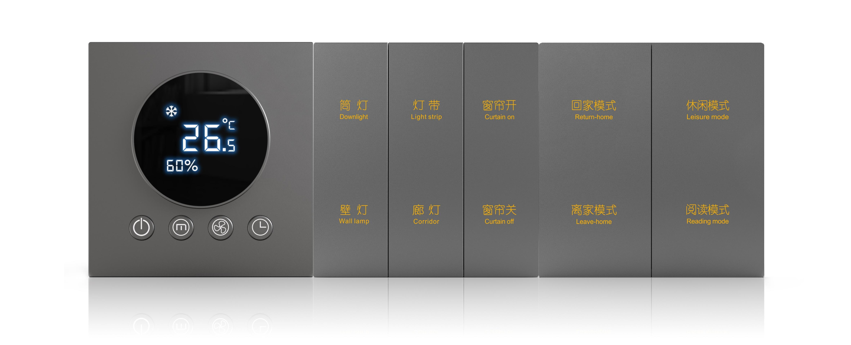
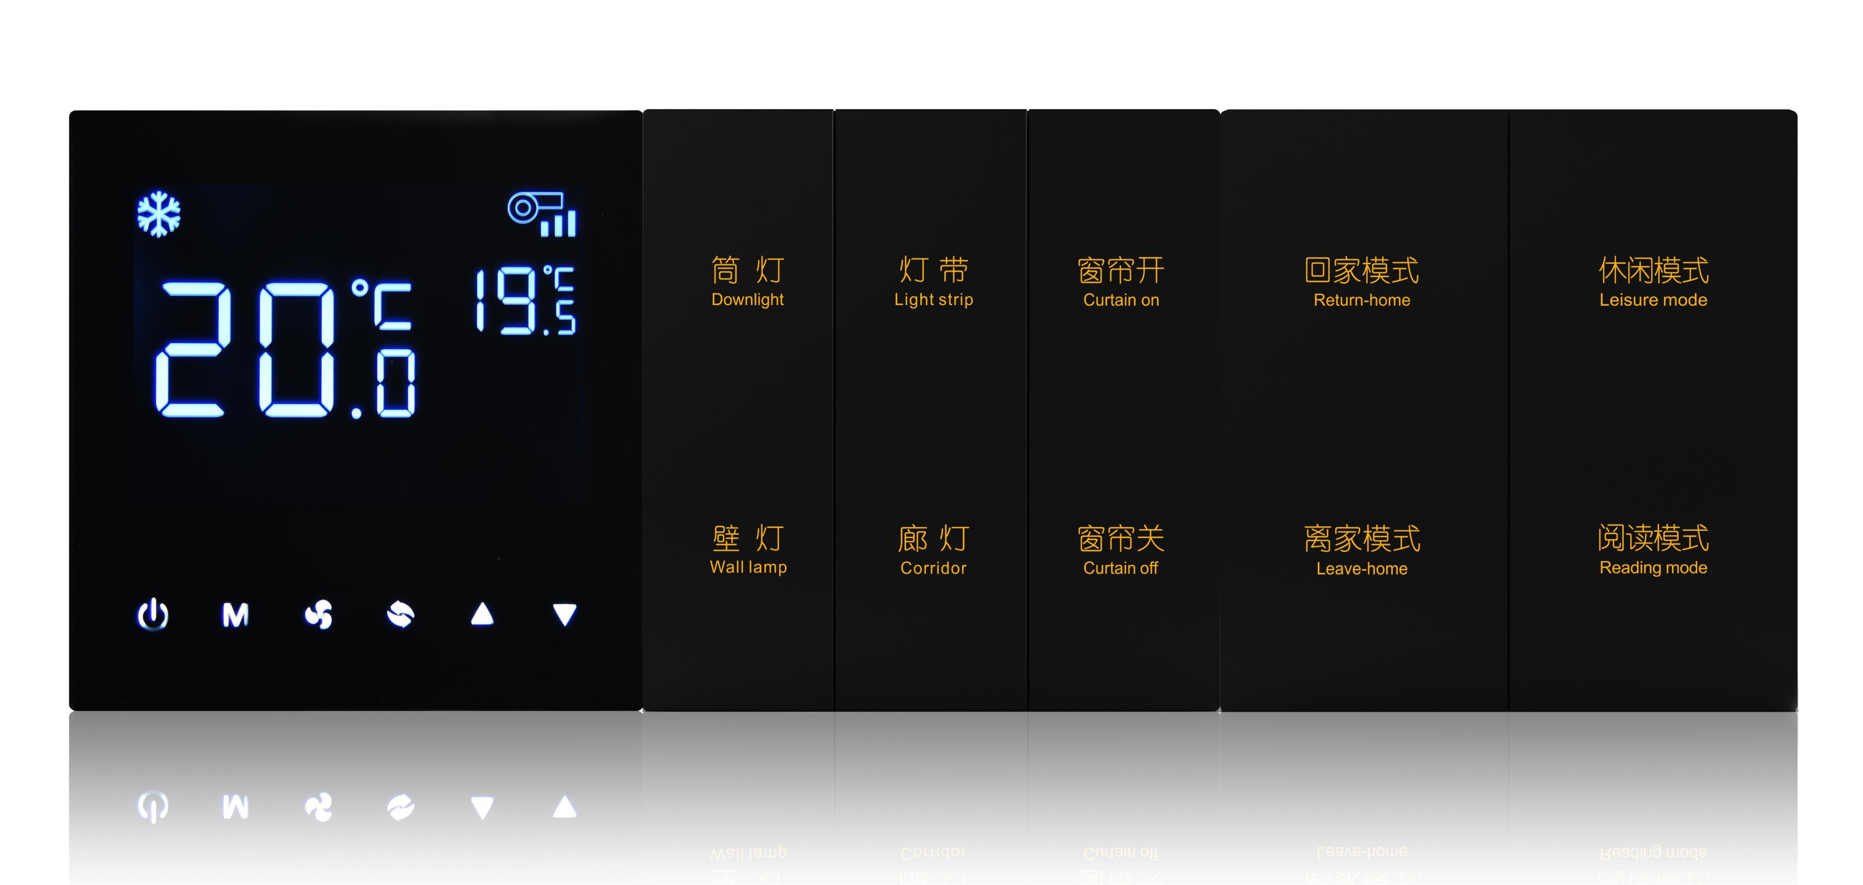
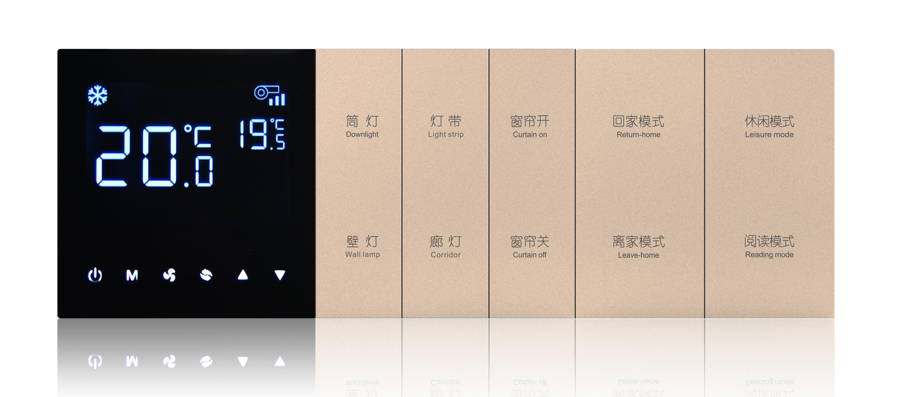
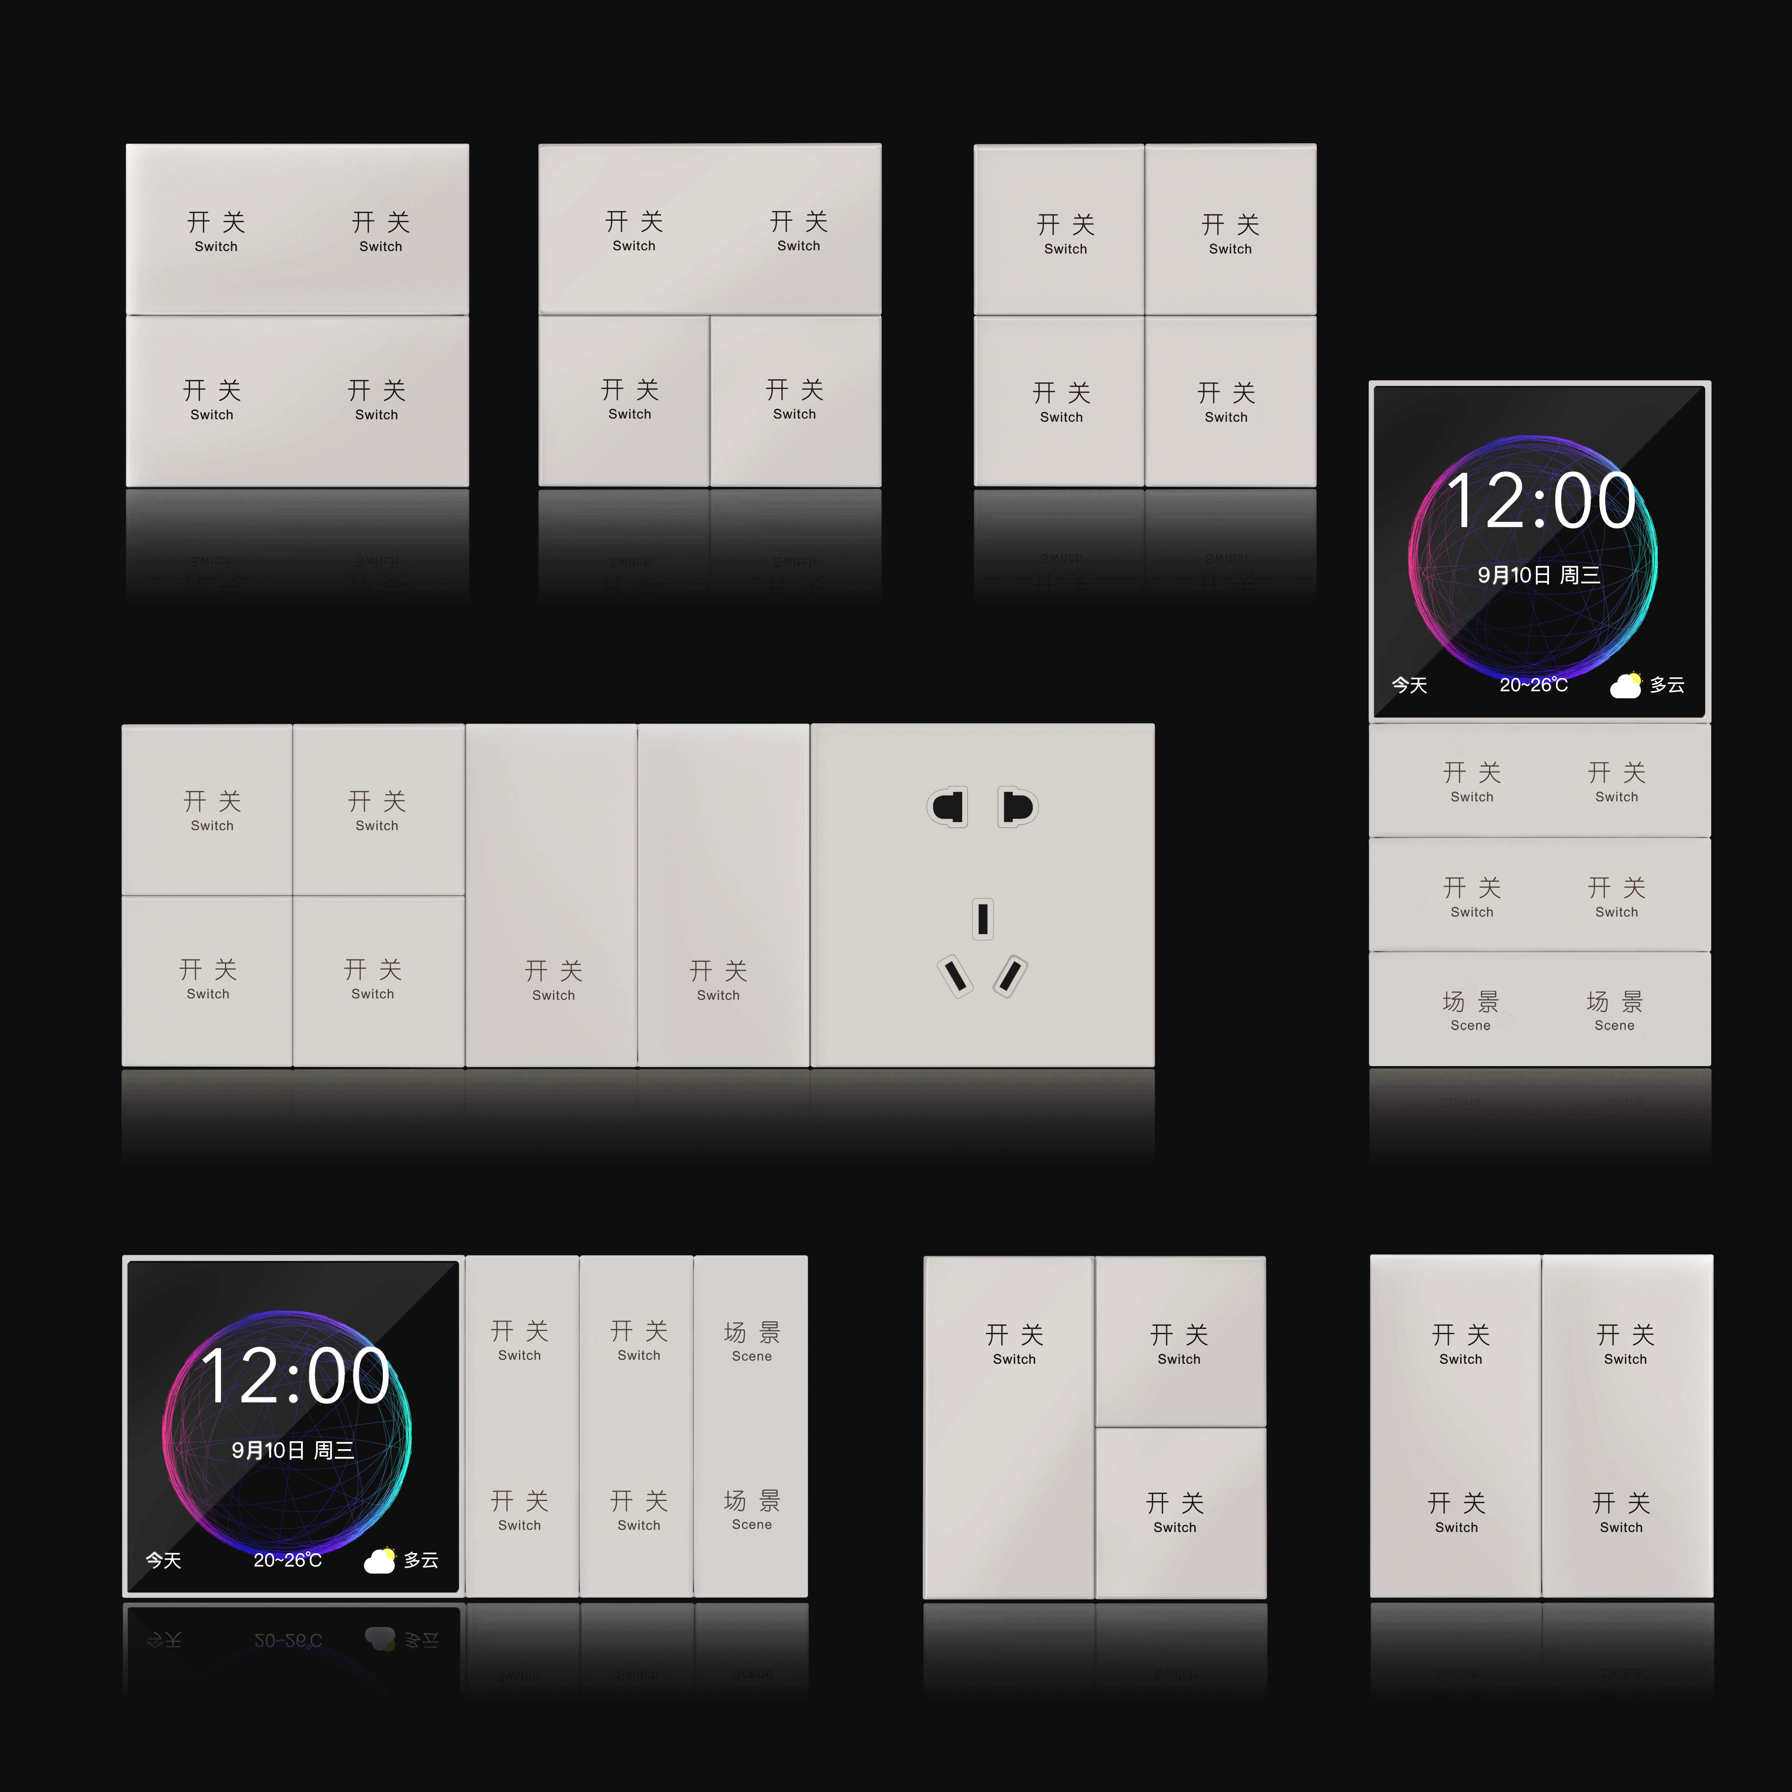
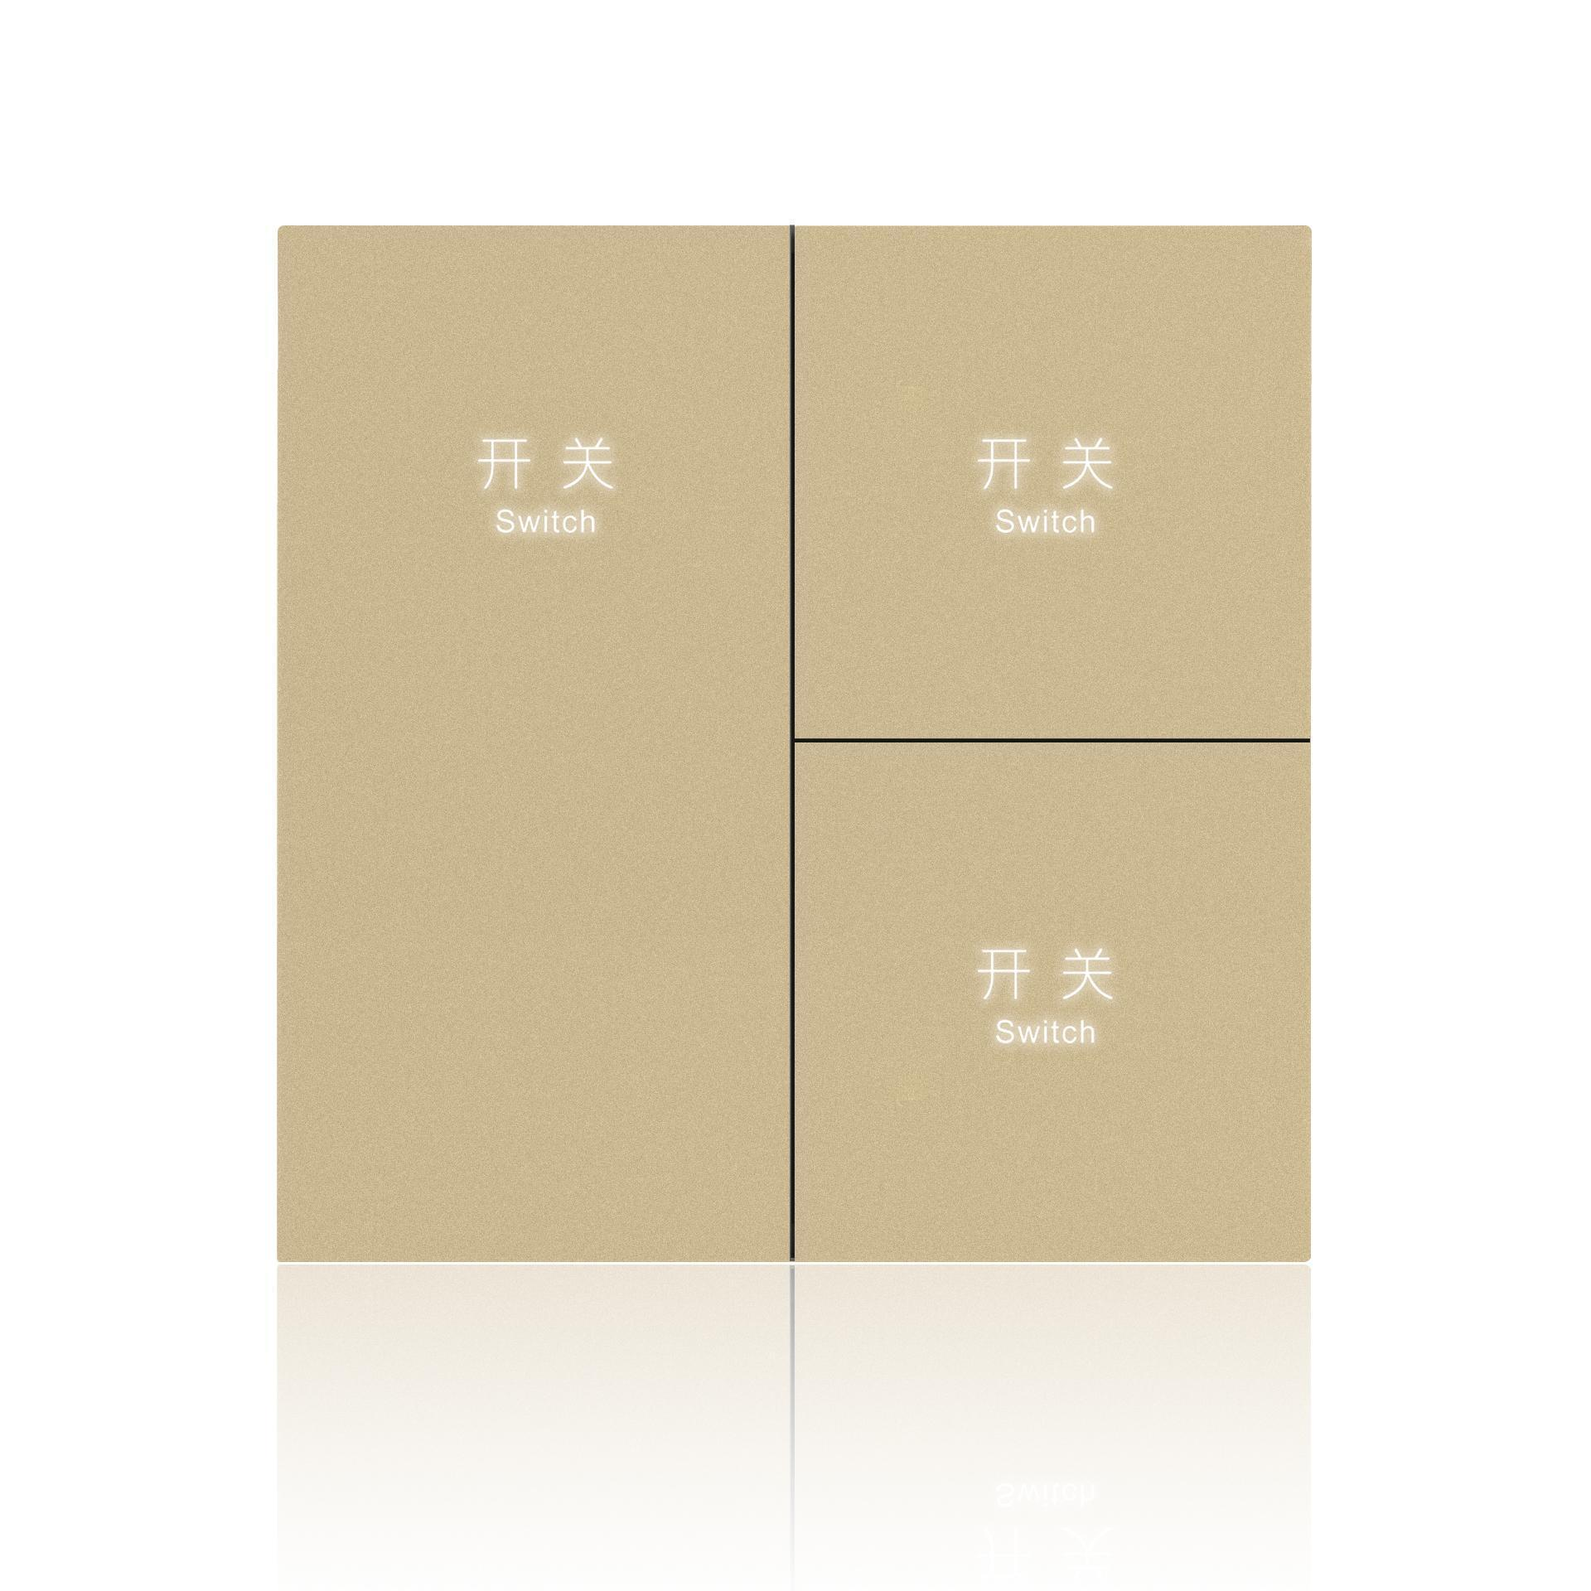
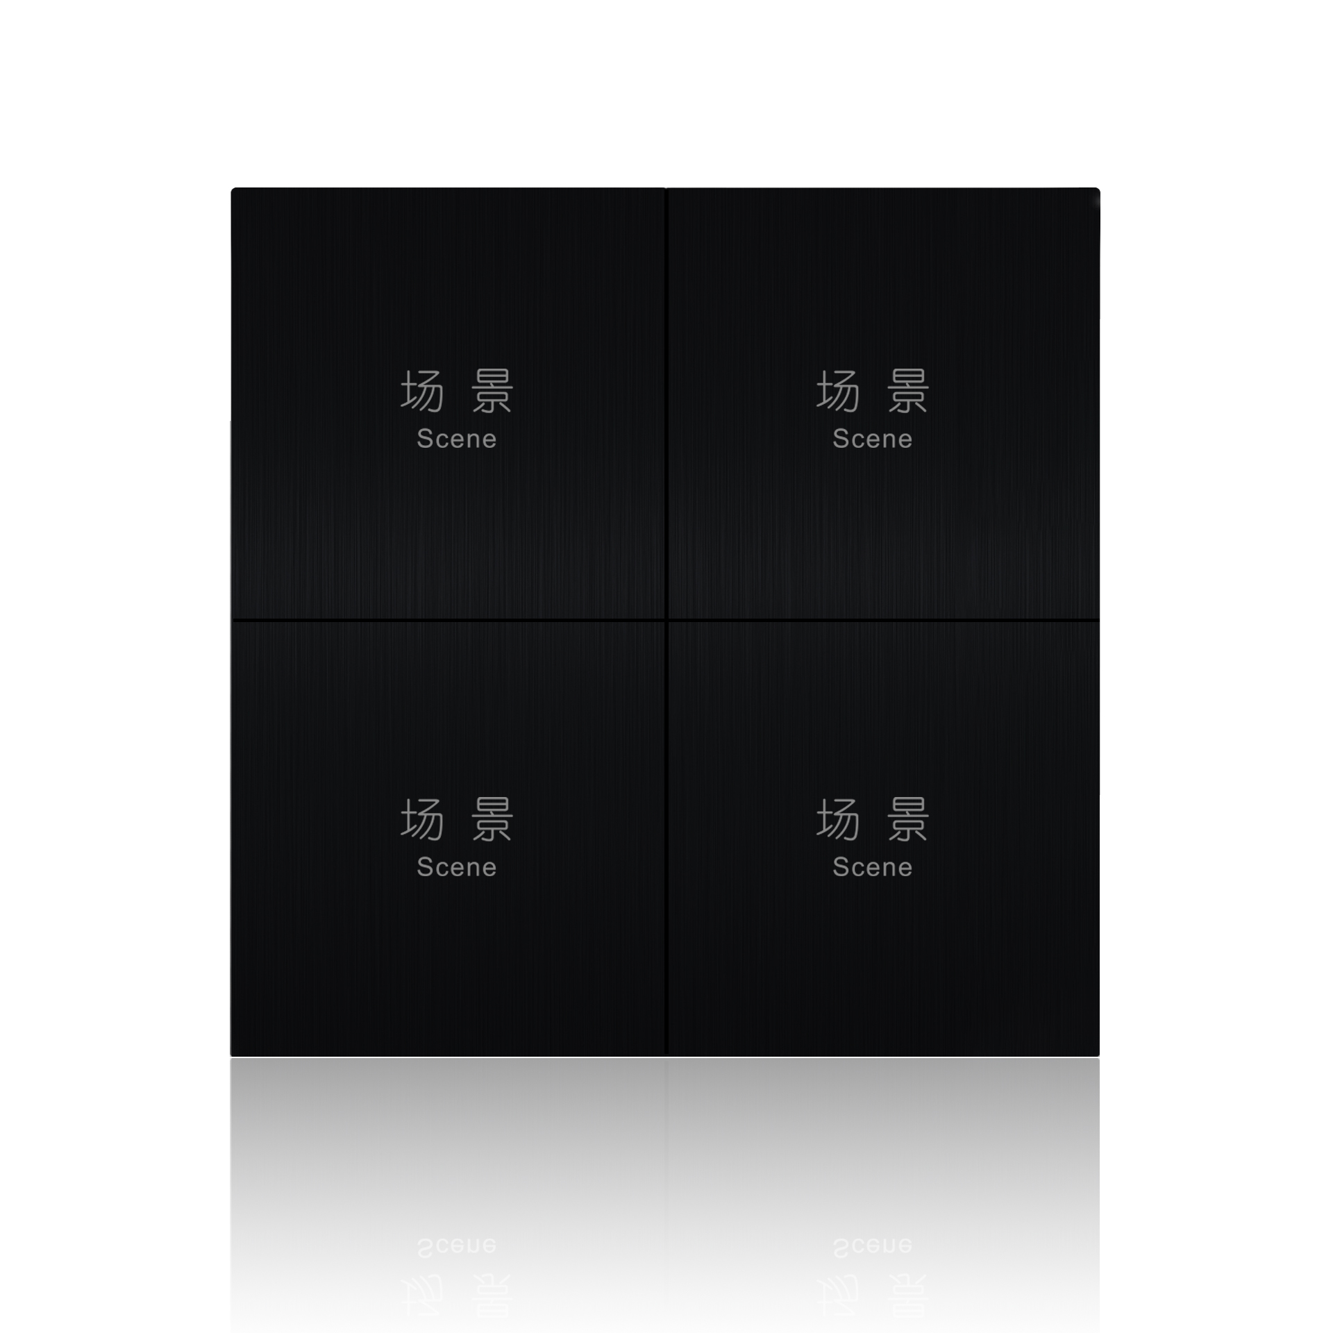
Switch Panel Portfolio -- D / M / G Series
HOTEKEY | BOX480 Platform | www.hotekey.com
13

Slide 14
Premium Switch Panels -- Design Meets Function
D Series (matte PC + metal), M Series (metal + glass), G Series (CNC aluminum) -- 1/2/3/4/6-gang, RS-485 and dry-contact protocols available
HOTEKEY | BOX480 Platform | www.hotekey.com
14

Slide 15
02
Guest Control Excellence
Light, Climate, Curtain -- Unified
HOTEKEY | BOX480 Platform | www.hotekey.com
2

Slide 16
Intelligent Lighting: More Than On/Off
Every great hotel room is defined by its lighting. Harsh overhead fluorescents kill ambiance. Thoughtful layered lighting creates an experience worth paying for.
BOX480 LIGHTING CAPABILITIES
Relay Switching -- 17 channels of on/off control for general lighting, accent lights, bathroom, corridor, reading lamps. Each channel individually configurable with delay, ramp, and memory settings.
0-10V Dimming -- Smooth 0-100% for LED drivers. Fade-in/fade-out timing adjustable per circuit. Perfect for cove lighting, downlight arrays, and decorative fixtures.
TRIAC Dimming -- Phase-cut for traditional dimmable loads. Works with most LED retrofit bulbs, halogens, and incandescent fixtures already installed.
Scene Integration -- Any combination of relay + dimming + curtain + HVAC can be bundled into a single scene. "Reading" activates bedside lamp at 40% warm, kills all other lights, and closes curtains halfway.
Emergency override: every module has physical bypass switches. If the control system fails completely, lights still work manually.
HOTEKEY | BOX480 Platform | www.hotekey.com
16

Slide 17
Climate Control & Curtain Automation
Two of the most-used room features are also the most energy-intensive. BOX480 manages both intelligently.
HVAC CONTROL
3-speed fan coil control + cooling/heating valve actuation. Thermostat integration via RS-485. Occupancy-based auto-adjustment: when the room is empty (key card removed), HVAC shifts to eco mode. Upon guest return, restores preferred temperature within 3 minutes.
PMS-linked pre-cooling: 15 minutes before expected arrival, the room reaches target temperature. No guest walks into a stuffy room.
CURTAIN CONTROL
DC motor control with position feedback. Open, close, stop, or percentage positioning (e.g., "curtains at 30%"). Super-quiet operation at <35dB. Integrated with welcome scene (auto-open upon check-in), sleep scene (auto-close), and wake-up scene (gradual open over 5 minutes).
Manual override: always. Pull the curtain gently and the motor releases. No fighting the automation.
HOTEKEY | BOX480 Platform | www.hotekey.com
17

Slide 18
Scene Modes: One Touch Transforms the Room
Six pre-configured scenes. Customizable per hotel brand. Consistent across every room.
WELCOME -- Curtains open. All lights to 60% warm. HVAC to comfort temp. TV displays personalized greeting. The room says "hello" before the guest looks for a switch.
BRIGHT -- All lights 100% cool white. Curtains open. For cleaning, inspection, or guests who prefer maximum visibility.
READING -- Bedside lamp 40% warm. All other lights off. Curtains halfway. Focused, quiet, personal.
SLEEP -- All lights off. Curtains close. HVAC to night mode (quiet fan, +-1 degree tolerance). DND indicator on. One tap on the bedside panel.
MOVIE -- Ambient lights dim to 10% amber. Curtains close. TV input selected. "Home theater" experience from one button.
MEDITATION -- Soft amber glow. Music playlist starts (if audio connected). Curtains partial. HVAC to gentle fan. Created for wellness-oriented properties.
Hotels can define unlimited custom scenes through the SaaS platform. Push updates to all rooms simultaneously.
HOTEKEY | BOX480 Platform | www.hotekey.com
18

Slide 19
03
In-Room Entertainment
HotelTVOS & Smart Screen Ecosystem
HOTEKEY | BOX480 Platform | www.hotekey.com
3

Slide 20
HotelTVOS: The Commercial Smart Screen OS
HotelTVOS is a purpose-built operating system for hotel televisions -- not a consumer smart TV with a hotel mode tacked on. It connects PMS, guest control, services, and content into one screen interface.
MULTI-SCENE DEPLOYMENT
Guest Rooms -- Welcome message, room control, service requests, entertainment, hotel info, shopping, membership
Lobby & Public Areas -- Digital signage, wayfinding, event schedules, promotions
Restaurants & Meeting Rooms -- Menu display, presentation casting, ambient content
MULTI-LANGUAGE
English, Chinese, Arabic, Spanish, French, and more. Language auto-detected from PMS guest profile. One hardware, any language.
SIX UI THEMES
Free themes included. Custom UI design available. Match your brand identity without custom development costs.
COMPREHENSIVE TV COMPATIBILITY
Supports all major smart TV brands (engineering + retail models). Set-top box option for retrofitting non-smart TVs. DTMB coaxial, IPTV gateway, carrier live APK, and one-box-per-room modes all supported.
HOTEKEY | BOX480 Platform | www.hotekey.com
20

Slide 21
Voice Control: TV Becomes Your Smart Butler
HotelTVOS turns the TV into a voice-controlled hub for the entire room. No separate smart speaker needed. Far-field microphones built into the TV or remote.
VOICE CAPABILITIES (PARTIAL LIST)
TV Control -- "Turn on TV" / "Volume up" / "Switch to Channel 5" / "Play romantic movie" -- natural language, no memorized commands
Guest Control -- "Turn off all lights" / "Set temperature to 22" / "Close curtains" / "Reading mode" -- voice commands route through BOX480 to the RS-485 bus
Hotel Services -- "Send slippers to Room 305" / "I need more towels" / "What time is breakfast?" / "Call front desk" -- service requests auto-routed to staff
Content Search -- "Find action movies" / "Show me comedies with Jackie Chan" -- by name, actor, genre
Hotel Info -- "What's the Wi-Fi password?" / "Pool hours" / "Gym location" -- instant answers without calling front desk
Multi-language voice input. Works with TV remote or smart speaker. All commands route through the same BOX480 backend for consistent execution.
HOTEKEY | BOX480 Platform | www.hotekey.com
21

Slide 22
TV + Guest Control: The Killer Feature
Most hotels install a smart TV system AND a guest control system from different vendors. The TV can't control the lights. The guest control can't show PMS messages. They coexist -- they don't collaborate.
With BOX480, the TV IS the guest control interface:
PMS-DRIVEN WELCOME
Guest checks in at front desk. TV auto-powers on with: "Welcome, Mr. Chen." Curtains open. Lights fade to welcome scene. HVAC adjusts to pre-set temperature. All triggered by PMS check-in. No staff intervention. No guest action required.
VISUAL ROOM CONTROL
TV screen shows an interactive room map. Guest touches "Bedside Lamp" on screen -> lamp turns on. Touches "Curtains" -> curtain control slider appears. Visual feedback for every action. No confusion about which button does what.
SERVICE REQUESTS WITH CONTEXT
Guest selects "Request Slippers" on TV. PMS knows it's Room 305. Staff app gets notification: "305 -- Slippers." Delivery robot dispatched. TV shows: "Your slippers will arrive in approx. 8 minutes." The entire chain -- request, dispatch, delivery, confirmation -- runs on one platform.
HOTEKEY | BOX480 Platform | www.hotekey.com
22

Slide 23

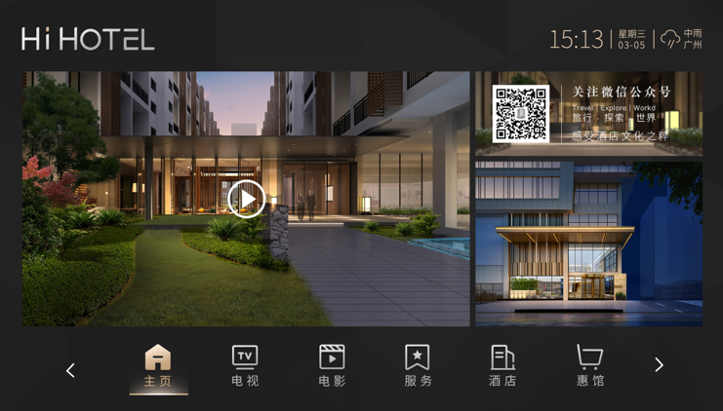
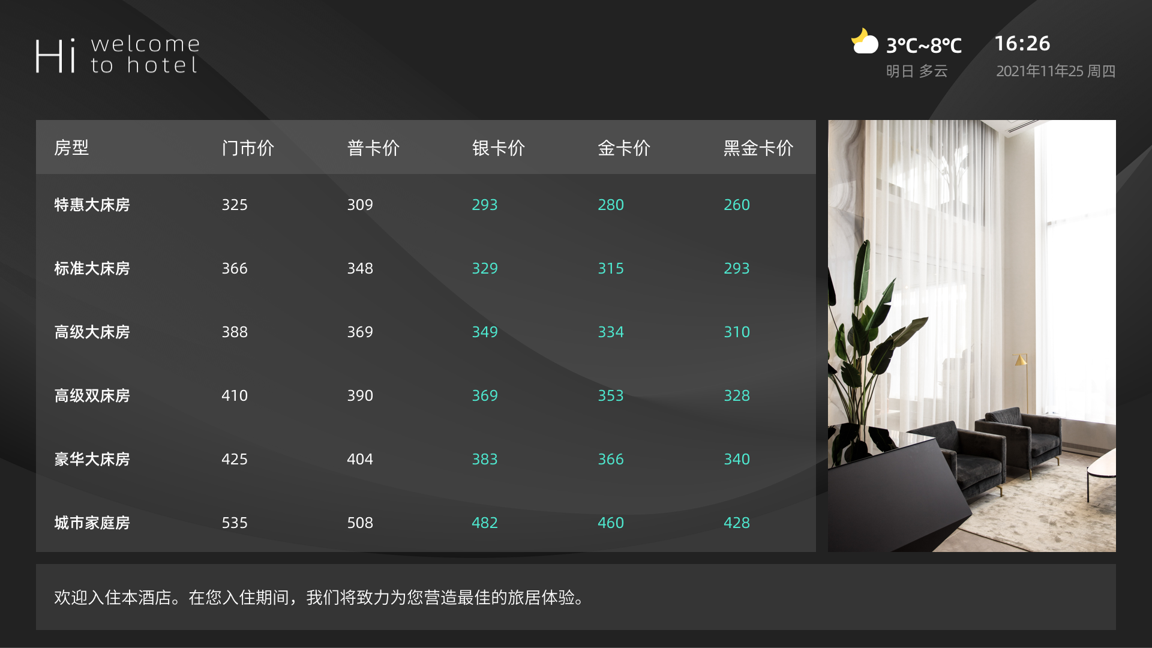
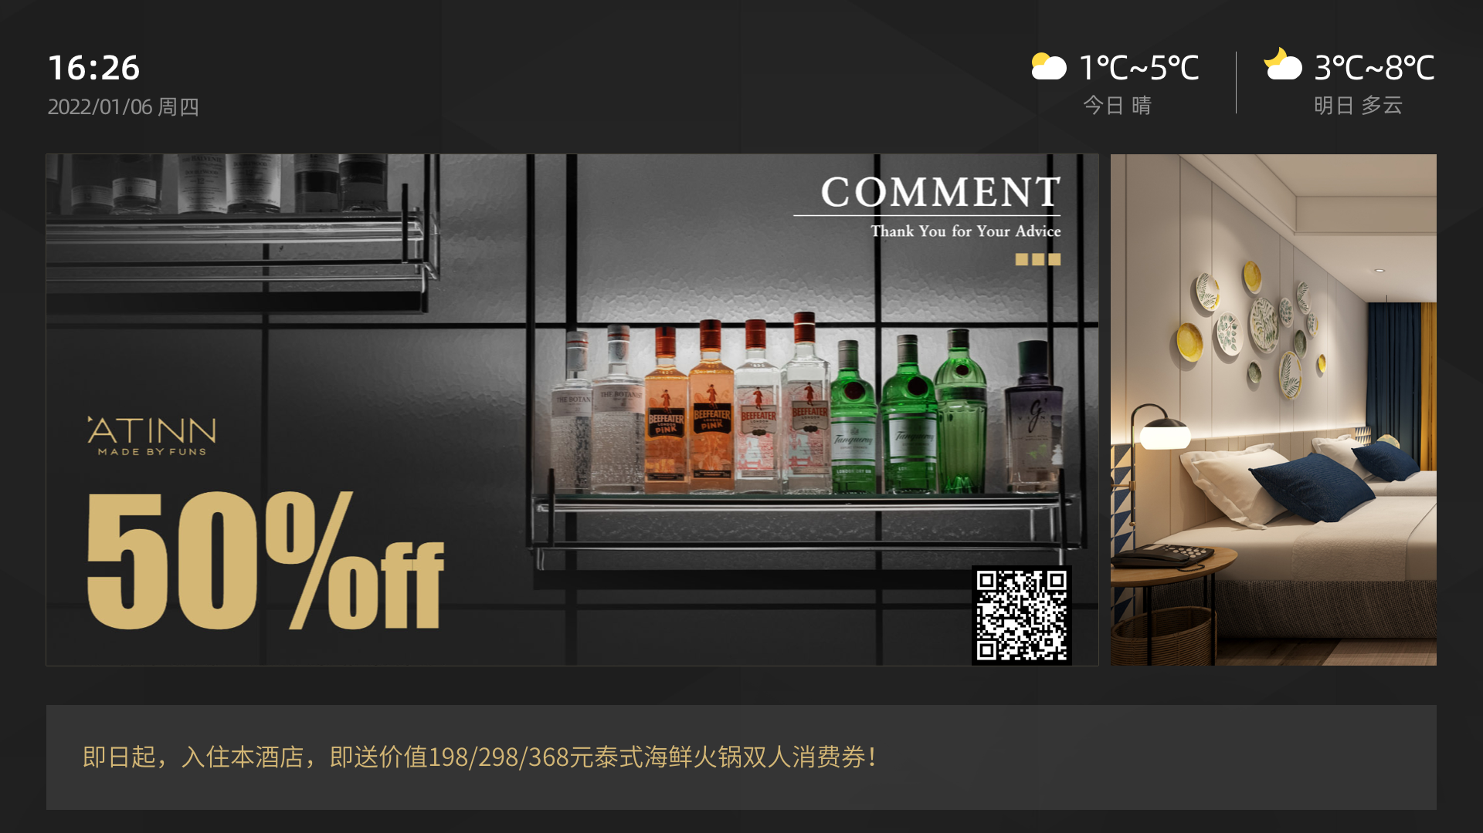
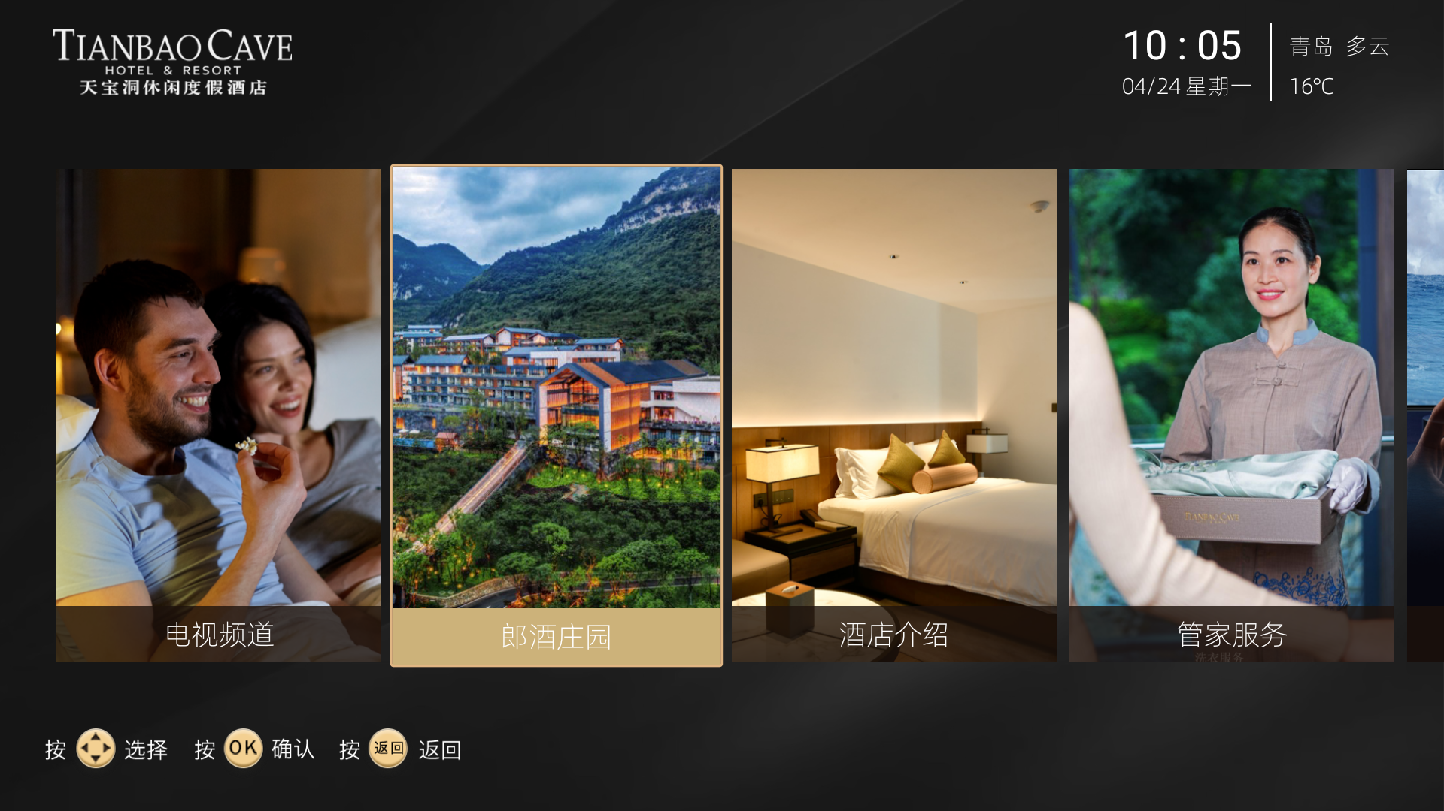

HotelTVOS -- Smart Screen Interfaces & UI Themes
HOTEKEY | BOX480 Platform | www.hotekey.com
23

Slide 24
04
Smart Services
Mobile App, Robot Integration & PMS
HOTEKEY | BOX480 Platform | www.hotekey.com
4

Slide 25
All-in-One Mobile: The Guest's Digital Concierge
One mobile app that replaces the 3-5 apps and QR codes guests typically encounter. Scan once. Control everything.
PRE-STAY
Online check-in. Room selection. Digital key issuance. Pre-set preferences: temperature, pillow type, welcome scene.
IN-STAY
Full room control (lights, AC, curtains). Service requests (cleaning, amenities, maintenance). In-room dining ordering. Hotel info & local guide. DND / Make Up Room toggle. Smart door lock control.
POST-STAY
Express checkout. Digital invoice. Feedback & review. Membership points redemption. Re-book with one tap.
TECHNICAL APPROACH
White-label to match your brand. OR embed into your existing hotel app via SDK. PMS-linked: the app knows which room, automatically. No manual pairing. No QR code scanning required.
The app becomes your direct channel to the guest -- bypassing OTAs for repeat bookings, upsells, and loyalty.
HOTEKEY | BOX480 Platform | www.hotekey.com
25

Slide 26
Robot Service Integration: Automated Delivery Workflow
BOX480 natively integrates with major robot platforms (Jingwu, Qinglang, Ninebot, Angbao, and others). The entire service chain -- guest request to delivery confirmation -- runs through one system.
END-TO-END FLOW
1. Guest requests item via TV voice, mobile app, or smart speaker
2. BOX480 creates a service ticket with room number, item, and priority
3. Staff receives notification on PC or mobile. Accepts and prepares item
4. Staff places item in robot. Robot navigates to guest room autonomously
5. BOX480 sends arrival notification via TV, phone, or SMS
6. Guest retrieves item. Ticket closed. Data logged for service analytics
The integration advantage:
Because BOX480 owns the entire chain, the guest can track their request status on the TV screen in real-time. No "where is my delivery?" calls to the front desk. Every step is visible.
HOTEKEY | BOX480 Platform | www.hotekey.com
26

Slide 27
PMS Integration: The Central Nervous System
The PMS (Property Management System) is the hotel's operational backbone. BOX480 was designed from day 1 to integrate with it -- not as an afterthought, but as a core architectural requirement.
SUPPORTED PMS PLATFORMS
Opera, Fidelio, and 30+ leading PMS systems. Custom integration available for proprietary or legacy PMS.
BI-DIRECTIONAL DATA FLOW
PMS -> BOX480: Check-in/out status, guest name & language, membership tier, special requests
BOX480 -> PMS: Room occupancy status, energy consumption, service requests, housekeeping status, device alerts
KEY AUTOMATIONS
Check-in triggers: welcome scene, HVAC pre-cool, TV welcome message, curtain open
Check-out triggers: all-off scene, HVAC eco mode, housekeeping notification, energy reset
Membership sync: VIP guests get premium welcome scene, loyalty points automatically credited
HOTEKEY | BOX480 Platform | www.hotekey.com
27

Slide 28
Data-Driven Hotel Operations
REAL-TIME DASHBOARD
MARKETING & MEMBERSHIP
Single-pane-of-glass for the entire property:
Room occupancy status (live)
Device health map (per room)
Energy consumption (per room/circuit)
Service request queue & SLA tracking
Guest satisfaction scores
Revenue per available room (RevPAR)
OTA ranking & review monitoring
All data refreshes automatically. Exportable reports for management review.
Turn every TV into a marketing channel:
Targeted promotions by guest segment
Membership signup with QR code overlay
In-room upsell (spa, dining, late checkout)
Push notifications via TV & mobile
Post-stay remarketing automation
Loyalty & membership auto-enrollment
Campaign performance analytics
Six marketing systems unified on one platform. No separate CRM, no separate campaign tool.
HOTEKEY | BOX480 Platform | www.hotekey.com
28

Slide 29
05
Why HOTEKEY
Proven at Scale. Built for the Future.
HOTEKEY | BOX480 Platform | www.hotekey.com
5

Slide 30
130,000+
Rooms Deployed Across 2,000+ Projects
HOTEKEY systems are operating in 130,000+ rooms across 2,000+ projects in China -- plus international deployments in Southeast Asia and the Middle East.
With over 10 years of combined experience in guest control systems and hotel TV systems, our engineering team has handled every edge case: complex TV models, legacy signal environments, tricky network topologies, and demanding integration requirements.
We don't learn on your project. We bring a decade of lessons to it.
HOTEKEY | BOX480 Platform | www.hotekey.com
30

Slide 31
Landmark Installations
BOX480 is trusted by some of the most demanding hospitality brands and properties:
BEIJING HOTEL (Nuo Jin) -- 5-star heritage property. Full BOX480 deployment with HotelTVOS, guest control, and PMS integration. Legacy building with complex electrical infrastructure successfully modernized.
DIAOYUTAI STATE GUESTHOUSE -- Diplomatic-grade hospitality. The highest standards for reliability, security, and service. BOX480 passed the most rigorous testing in the industry.
WANDA MOMENTS HOTEL (Laos) -- First overseas deployment. 200+ rooms. Full BOX480 platform deployed in a Southeast Asian market. Multi-language support in action.
HUAZHU / JINJIANG / GREENTREE -- Major hotel groups. BOX480 integrated with group-level PMS, membership systems, and brand standards. Multi-property unified management dashboard.
Our projects range from 50-room boutiques to 1,000+ room convention hotels. Same platform. Same quality. Scaled to fit.
HOTEKEY | BOX480 Platform | www.hotekey.com
31

Slide 32
Professional Project Delivery
ENGINEERING EXCELLENCE
SERVICE COMMITMENT
5S quality management system:
Standardized wiring practices
Pre-labeled cables & terminals
Professional electrical cabinet assembly
Full testing before shipment
Photo documentation of every install
Certification: ISO 9001, CE, 3C
Our installation teams are trained, certified, and experienced. We don't subcontract critical electrical work.
Comprehensive after-sales support:
24/7 technical support hotline
Remote diagnostics & troubleshooting
OTA firmware updates
On-site service within 48 hours
Spare parts inventory guarantee
Staff training (on-site + remote)
We maintain direct subsidiary offices in key regions for rapid response. No third-party service agents.
HOTEKEY | BOX480 Platform | www.hotekey.com
32

Slide 33
Nationwide Coverage & Global Reach
Our implementation and service network covers every province, autonomous region, and municipality in China -- as well as growing international presence.
GUANGZHOU HEADQUARTERS
R&D center with 50+ engineers. In-house manufacturing (SMT lines, assembly, testing lab). Central warehouse for rapid fulfillment. Global technical support center (English + Chinese).
SINGAPORE OFFICE
International business hub. Sales, project management, and on-the-ground support for Southeast Asia, Middle East, and global markets. Multi-language documentation and training capabilities.
CONSAP PTE LTD (Regional Partner) — aismarthotel@consap.sg · +65 9435 7730 (WhatsApp)
REGIONAL SERVICE CENTERS
Direct subsidiary offices in key Chinese cities for rapid on-site response. All offices staffed with certified engineers -- not third-party contractors. Consistent service quality nationwide.
TARGET INTERNATIONAL MARKETS
Southeast Asia . Middle East . Central Asia . South Asia . Russia/CIS . Africa
HOTEKEY | BOX480 Platform | www.hotekey.com
33

Slide 34
Digital Operations Platform: Manage Everything from One Screen
The BOX480 SaaS platform is the command center for the entire hotel. Four integrated management systems in one login:
HOTEL MANAGEMENT SYSTEM
Group/brand/region hierarchical management. Real-time operational BI dashboard. Room status monitoring. Staff performance metrics. Revenue and occupancy analytics.
HOTEL O&M SYSTEM
Device health monitoring: every switch, dimmer, and relay status visible in real-time. Predictive alerts. Remote configuration push. Batch firmware updates. Work order auto-generation when anomalies detected.
DATA ANALYTICS SYSTEM
Per-room energy consumption graphs. Guest behavior pattern analysis. Service request trends. Peak usage heatmaps. All data exportable. API available for third-party BI tools.
AIoT SYSTEM
AI-driven anomaly detection. Occupancy prediction for energy optimization. Device lifecycle management. Automated maintenance scheduling. The platform gets smarter as it collects more data.
Available on web, tablet, and mobile. Role-based access control. Multi-property view for groups.
HOTEKEY | BOX480 Platform | www.hotekey.com
34

Slide 35
How We Partner With You
We're not a box-shipper. We're a technology partner who stays with you from design to day-to-day operations.
PROJECT DELIVERY PROCESS
1. REQUIREMENTS -- We sit with your team to understand brand standards, room types, integration points, and timeline
2. DESIGN -- BOM specification, electrical cabinet layout, wiring diagram review, sample room plan
3. SAMPLE ROOM -- Build and commission a model room. Stakeholder walkthrough. Adjust until perfect.
4. PRODUCTION & DELIVERY -- Hardware manufactured, tested, pre-configured. SaaS platform provisioned. Train-the-trainer sessions.
5. ON-SITE COMMISSIONING -- Our engineers on site. Room-by-room verification. Integration testing. Performance validation.
6. HANDOVER -- Documentation package. Staff training. 24/7 support activated. You're live.
We support projects from 50 to 5,000+ rooms. Pilot programs available for first-time partners.
HOTEKEY | BOX480 Platform | www.hotekey.com
35

Slide 36
Global Support, Local Presence
HOTEKEY operates a dual-headquarters model to serve hotel projects worldwide:
GUANGZHOU, CHINA -- Engineering & Manufacturing Hub
R&D center with 50+ engineers. In-house SMT production and assembly lines. Full product testing and certification lab. Central inventory warehouse. 24/7 technical support in English and Chinese.
SINGAPORE -- International Business Hub
Sales and project management for global markets. On-the-ground support for overseas projects. Multi-language documentation, training, and technical communication. Regional partner network coordination.
CONSAP PTE LTD (Regional Partner) — aismarthotel@consap.sg · +65 9435 7730 (WhatsApp)
READY TO SERVE
Our teams have deployed systems in China, Southeast Asia, and beyond. We understand local electrical standards, building codes, and cultural expectations. We don't export a Chinese product -- we deliver a globally-adapted solution.
Contact us to discuss your project.
HOTEKEY | BOX480 Platform | www.hotekey.com
36

Slide 37
Let's Build the Smart Hotel of Tomorrow
One platform. Every system. Zero fragmentation.
CHINA HEADQUARTERS
luka@hotekey.com
+86 13925188886 (WhatsApp)
SINGAPORE — SEA OPERATIONS (Regional Partner: CONSAP PTE LTD)
aismarthotel@consap.sg
+65 9435 7730 (WhatsApp)
HOTEKEY | Guangzhou Hotekey Electronics Co., Ltd.
Guangzhou, China · Singapore | www.hotekey.com
HOTEKEY | BOX480 Platform | www.hotekey.com
37

